Slide 1
BLAST:Basic Local Alignment Search Tool
In this part let me introduce to you guys some information about BLAST :
1 why we use it
2 its types
3 the difference between its type

Slide 2
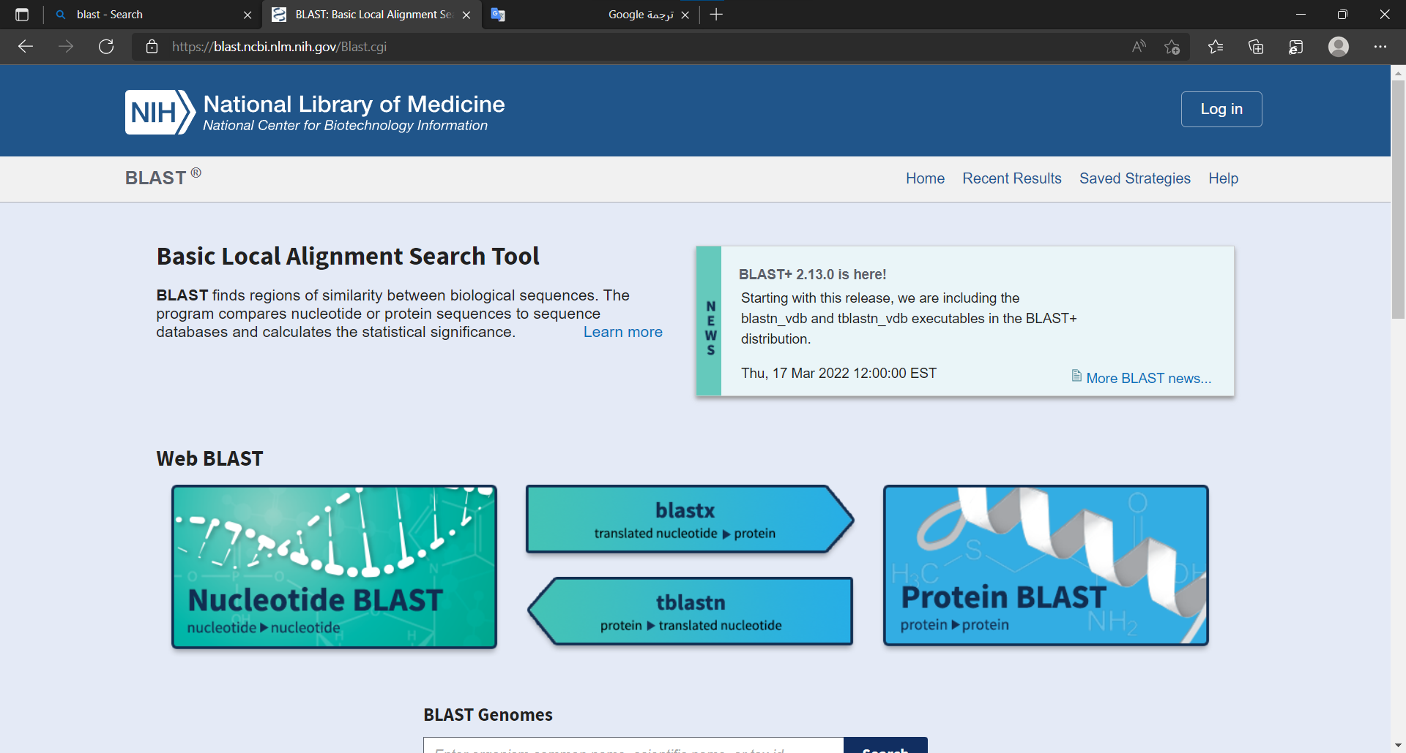

Slide 3
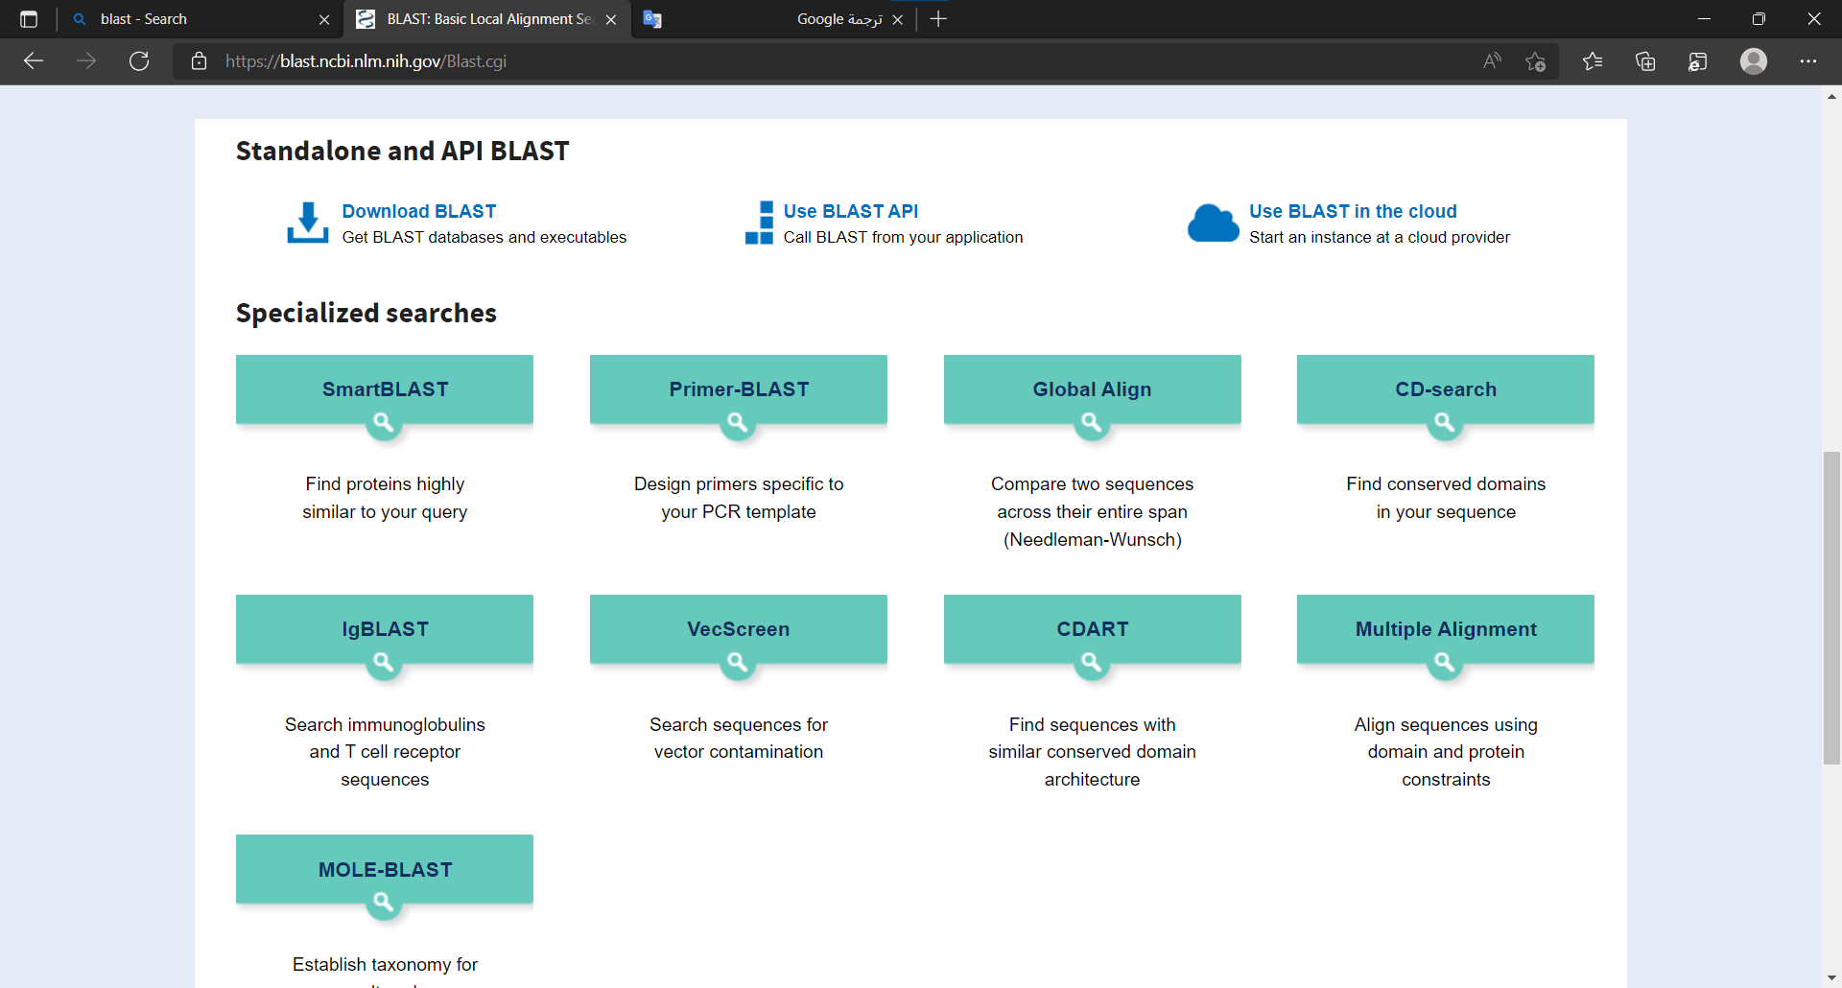

Slide 4
1 why we use BLAST
BLAST finds regions of similarity between biological sequences
The program compares nucleotide or protein sequences to sequence databases and calculates the statistical significance
finds regions of local similarity between sequences
More fast and quick

Slide 5
Its types
1 BLASTn
(Nucleotide BLAST): compares one or more nucleotide query sequences to a subject nucleotide sequence or a database of nucleotide sequences. This is useful when trying to determine the evolutionary relationships among different organisms (see Comparing two or more sequences below).
2 BLASTx
(translated nucleotide sequence searched against protein sequences): compares a nucleotide query sequence that is translated in six reading frames (resulting in six protein sequences) against a database of protein sequences. Because blastx translates the query sequence in all six reading frames and provides combined significance statistics for hits to different frames, it is particularly useful when the reading frame of the query sequence is unknown or it contains errors that may lead to frame shifts or other coding errors. Thus blastx is often the first analysis performed with a newly determined nucleotide sequence.

Slide 6
3 tBLASTn
(protein sequence searched against translated nucleotide sequences): compares a protein query sequence against the six-frame translations of a database of nucleotide sequences
BLASTp (Protein BLAST): compares one or more protein query sequences to a subject protein sequence or a database of protein sequences. This is useful when trying to identify a protein (see From sequence to protein and gene below)

Slide 7
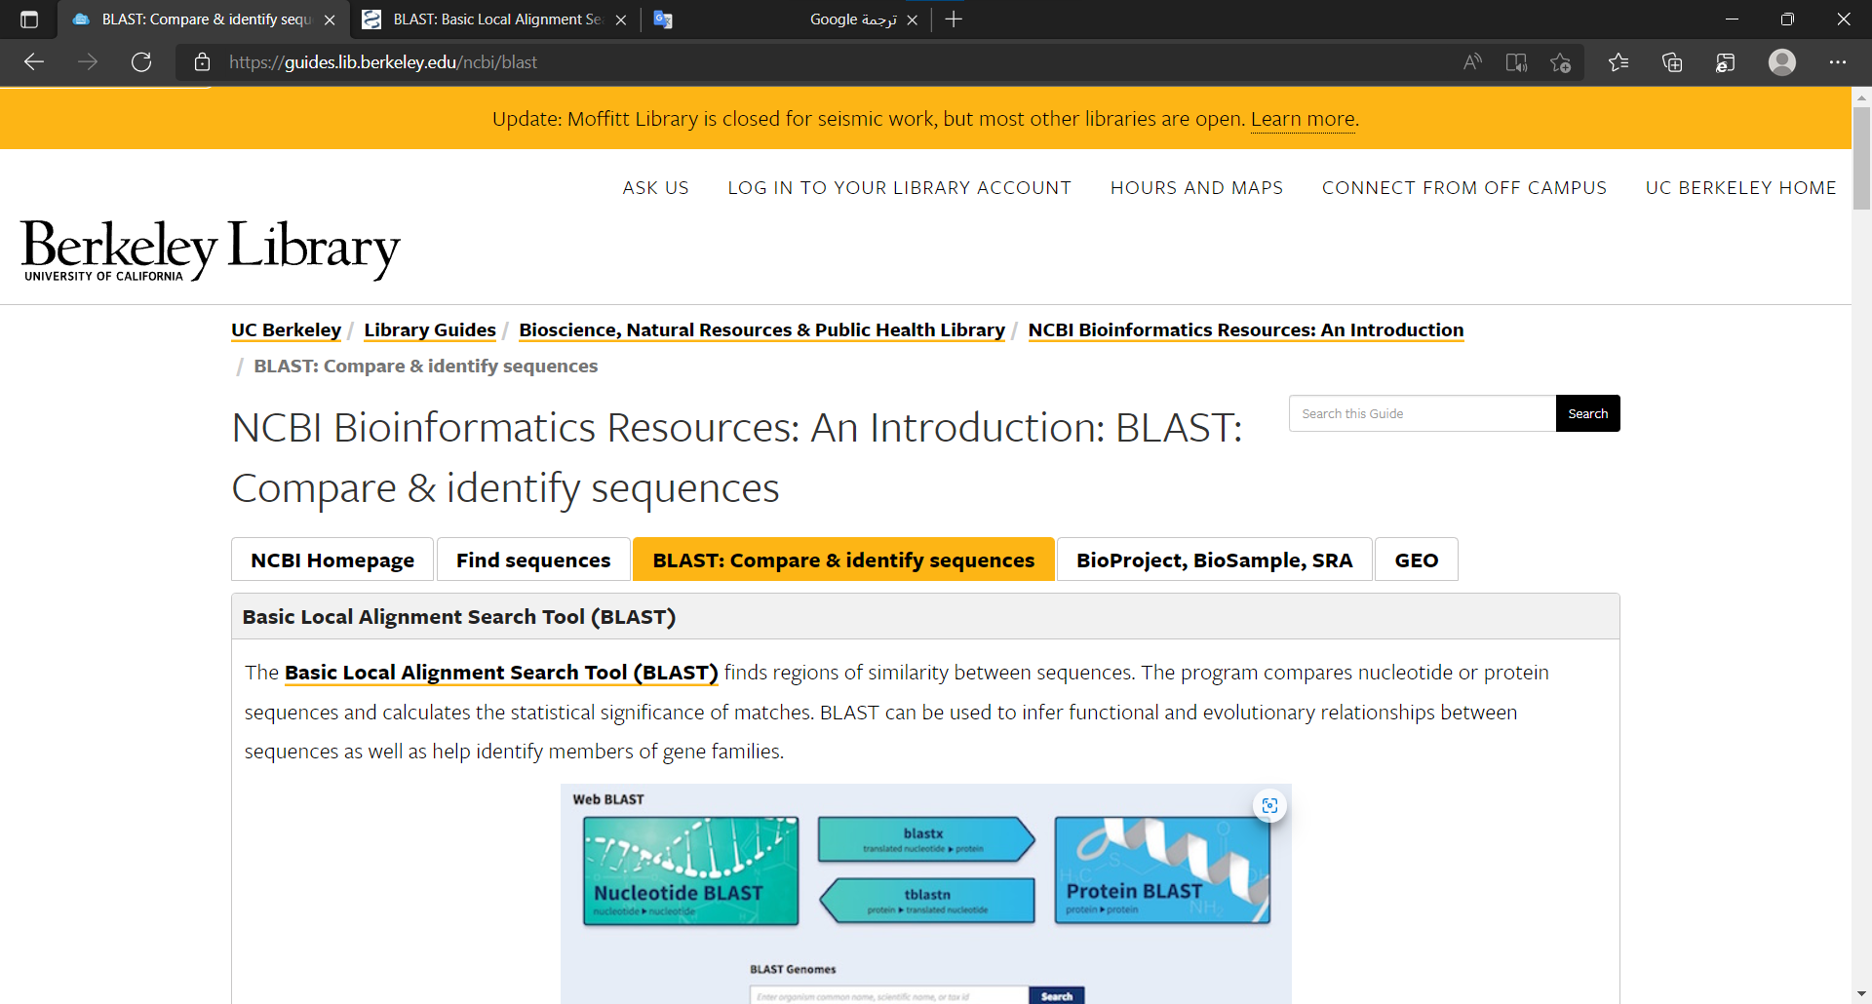

Slide 8
